Slide 1
Recommendation System Using Spotify API
Justin grisanti

Slide 2
Objectives – 5 Step Model
Obtain Business Understanding
Understand the Data
Prepare Data for Modeling
Create Models
Generate Results

Slide 3


Business Understanding
Business Problem
Easier to access music
Millions of available songs
Paradox of Choice
Notes:
Problem: I would argue that music is now one of the easiest forms of media to consume, due to smartphone technology allowing users to access millions of songs at their fingertips. However, with all of these choices, it is hard to know where to begin when it comes to finding new music that matches someone’s preferences, and users may become overwhelmed when trying to find music

Slide 4
Business Understanding
Stakeholders
Spotify Users
DJs
Solution
Content-Based Recommendation System
Helps a user find similar music
Other Music-Related professionals
Notes:
Stakeholders: Labels looking for independent talent
Solution: Content-based recommendation system that can take an existing playlist of user-added songs, and suggest more songs that are similar

Slide 5
Data Understanding
Spotify Million Playlist Dataset
1m Playlists
2.2m Unique Songs
734k Unique Albums
295k Unique Artists
Selected top 100 playlists (number of followers) from 200k playlists

Slide 6
Data Understanding
Spotify Library: Spotipy
A lightweight Python library for the Spotify Web API. With Spotipy you get full access to all the music data provided by the Spotify platform.
Notes:
Source additional data for tracks such as genre and popularity

Slide 7
Data Preparation
Playlist/Track Vectors
Audio Features
Popularity
Genre

Slide 8
Data Preparation
Audio Features
Valence (Positive)
Instrumentalness
Energy
Etc.

Slide 9

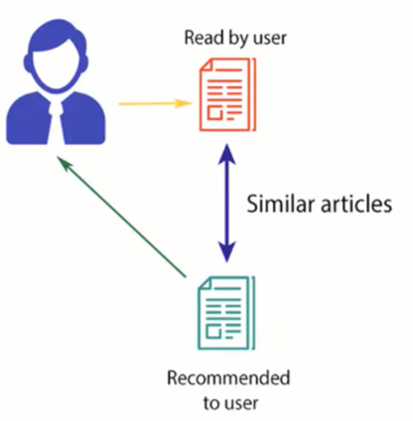



Modeling: Content-Based Filtering

Slide 10
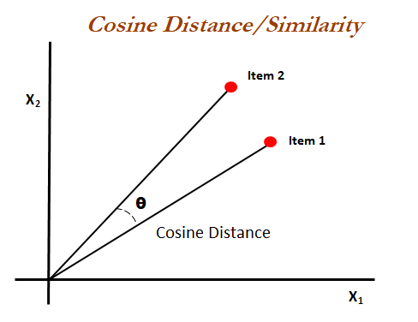
Metric: Cosine Similarity

Slide 11
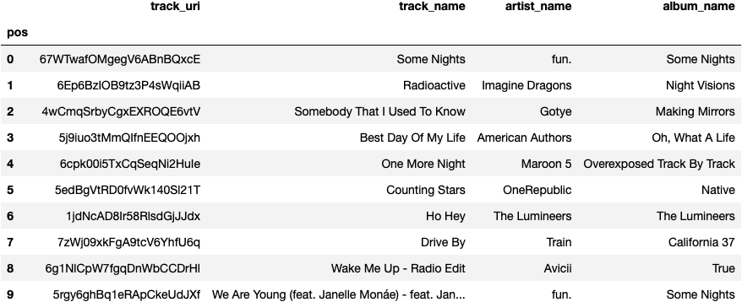
Modeling: Playlist #102585

Slide 12
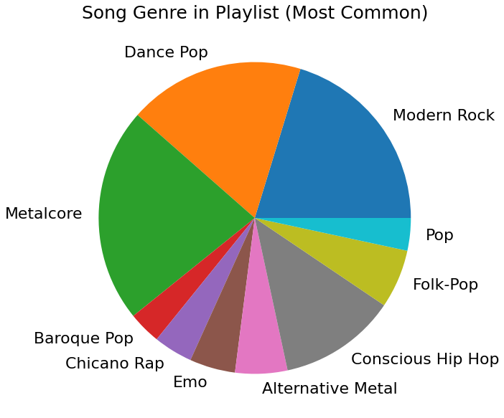
Modeling: Playlist #102585

Slide 13
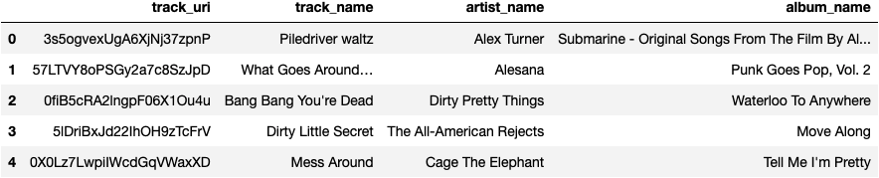
Modeling: Playlist #102585
Notes:
Songs pass the reasonableness test, getting mainly alternative/rock songs that captures the sound of the playlist

Slide 14
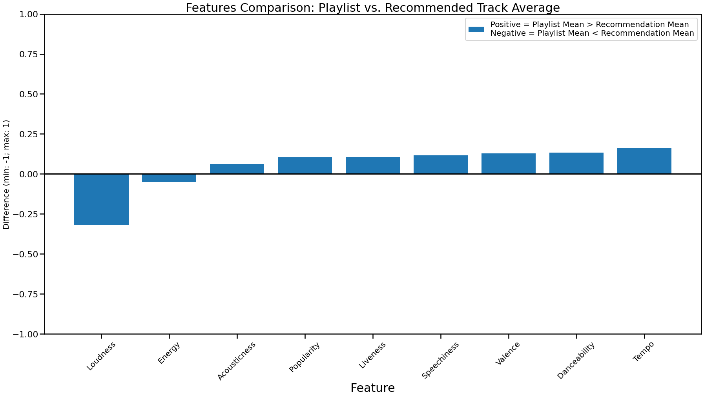
Modeling: Playlist #102585

Slide 15
Results
Aggregate difference low for our recommendations
Recommendations appear to be mainly driven by genre
Audio Features and Popularity then provide differentiation once the main genres are selected
Drawbacks:
Suggesting songs from the same basket that the machine is learning from may lead to bias
There are few metrics to assess content-based filtering, which makes it harder to determine the broader successfulness of the model
Subjective analysis can lead to bias

Slide 16
Next Steps
Easier Genre Export from Spotipy
Release-Date Data
User-review Data -> Collaborative-Based Filtering
Research clustering
Use a more powerful computer to use all Spotify data

Slide 17
Thank you For Your Time!
LinkedIn
Project Link
GitHub Profile

